Slide 1


Principle of Computer Networks Experiment - Lesson 2
Lecture: Bo Yang
Professor at School of CS
Northwestern Polytechinal University
Fall semester 2022
yang_bo@nwpu.edu.cn

Slide 2
Goals
1. TCP Communications
2. Socket API
3. TCP via socket API

Slide 3
Goals
1. TCP Communications
2. Socket API
3. TCP via socket API

Slide 4


Principles of reliable data transfer
sending process
receiving process
application
data
data
transport
reliable channel
reliable service abstraction
Notes:
note arrows through reliable data transfer channel is just one way – reliably send from sender to receiver

Slide 5

Principles of reliable data transfer
sending process
receiving process
sending process
receiving process
application
data
data
application
data
data
transport
transport
reliable channel
sender-side of
reliable data transfer protocol
receiver-side
of reliable data transfer protocol
reliable service abstraction
transport
network
unreliable channel
reliable service implementation
Notes:
Spend some time talking about how its to the sender and receiver side protocol that IMPLEMENTS reliable data transfer
Communication over unreliable channel is TWO-way: sender and receiver will exchange messages back and forth to IMPLEMENT one-way reliable data transfer

Slide 6
Principles of reliable data transfer
sending process
receiving process
application
data
data
transport
sender-side of
reliable data transfer protocol
receiver-side
of reliable data transfer protocol
Complexity of reliable data transfer protocol will depend (strongly) on characteristics of unreliable channel (lose, corrupt, reorder data?)
transport
network
unreliable channel
reliable service implementation
Notes:
So we have a sender side and a receiver side. How much work they’ll have to do depends on the IMPAIRMENTS introduced by channel – if the channel is perfect – no problem!

Slide 7



Principles of reliable data transfer
sending process
receiving process
application
data
data
transport
sender-side of
reliable data transfer protocol
receiver-side
of reliable data transfer protocol
Sender and receiver do not know the “state” of each other, e.g., was a message received?
unless communicated via a message
transport
network
unreliable channel
reliable service implementation
Notes:
Here’s a point of view to keep in mind – it’s easy for US to look at sender and receiver together and see what is happening. OH – that message sent was lost.
But think about it say from senders POV How does the sender know if its transmitted message over the unreliable channel got though?? ONLY if receiver somehow signals to the sender that it was received.
The key point here is that one side does NOT know what is going on at the other side – it’s as if there’s a curtain between them. Everything they know about the other can ONLY be learned by sending/receiving messages.
Sender process wants to make sure a segment got through. But it can just somehow magically look through curtain to see if receiver got it. It will be up to the receiver to let the sender KNOW that it (the receiver) has correctly received the segment.
How will the sender and receiver do that – that’s the PROTOCOL.
Before starting to develop a protocol, let’s look more closely at the interface (the API if you will)

Slide 8









Reliable data transfer protocol (rdt): interfaces
rdt_send(): called from above, (e.g., by app.). Passed data to deliver to receiver upper layer
deliver_data(): called by rdt to deliver data to upper layer
sending process
receiving process
rdt_send()
data
data
deliver_data()
data
sender-side
implementation of rdt reliable data transfer protocol
receiver-side
implementation of rdt reliable data transfer protocol
packet
udt_send()
Header
data
Header
data
rdt_rcv()
unreliable channel
udt_send(): called by rdt
to transfer packet over
unreliable channel to receiver
rdt_rcv(): called when packet arrives on receiver side of channel
Bi-directional communication over unreliable channel

Slide 9






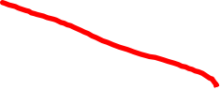


Reliable data transfer: getting started
We will:
incrementally develop sender, receiver sides of reliable data transfer protocol (rdt)
consider only unidirectional data transfer
but control info will flow in both directions!
we use finite-state machines (FSM) to specify the state of thg sender and receiver
Send/receive
event causing state transition
IDLE
actions taken on state transition
BUSY
state: when in this “state”, next state uniquely determined by next event
state
1
state
2
event
actions
Notes:
SO let’s get started in developing our reliable data transfer protocol, which we’ll call rdt (need a good acronym for protocol – like HTTP, TCP, UDP, IP)
Bullet points 1 and 2
NOW if we are going to develop a protocol, so we’ll need some way to SPECIFY a protocol. How do we do that?
We could write text, but as all know, that’s prone to misinterpretation, and might be incomplete. You might write a specification, and then think “oh yeah – I forgot about that case”
What we need is more formal way to specify a protocol. In fact, with a formal specification there may be ways to PROVE PROPERTIES about a specification. But that’s an advanced topic we won’t get into here. We’ll start here by adopting a fairly simple protocol specification technique known as finite state machines (FSM)
And as the name might suggest, a central notion of finite state machines is the notion of STATE
<talk about state>

Slide 10






Reliable transfer over a reliable channel
Underlying channel perfectly reliable
no bit errors
no loss of packets
Separate FSMs for sender, receiver:
sender sends data into underlying channel
receiver reads data from underlying channel
Wait for call from above
rdt_send(data)
Wait for call from below
rdt_rcv(packet)
sender
packet = make_pkt(data)
udt_send(packet)
receiver
extract (packet,data)
deliver_data(data)
Notes:
We’ll start with the simplest case possible - an unreliable channel that is, in fact perfect – no segments are lost, corrupted, dupplicated or reordered. The sender just sends and it pops out the other side(perhaps after some delay) perfectly.

Slide 11
Reliable transfer over a channel with bit errors
Underlying channel may flip bits in packet
checksum (e.g., Internet checksum) to detect bit errors
Question:
How do humans recover from “errors” during conversation?
Handshake Protocol !!

Slide 12
Reliable transfer over a channel with bit errors
Question: how to recover from errors?
acknowledgements (ACKs): receiver explicitly tells sender that pkt received OK!
negative acknowledgements (NAKs): receiver explicitly tells sender that pkt had errors!
sender retransmits pkt on receipt of NAK
stop and wait
sender sends one packet, then waits for receiver response

Slide 13




FSM (finite-state machine) specifications
rdt_send(data)
snkpkt = make_pkt(data, checksum)
udt_send(sndpkt)
rdt_rcv(rcvpkt) &&
isNAK(rcvpkt)
sender
Wait for call from above
Wait for ACK or NAK
udt_send(sndpkt)
rdt_rcv(rcvpkt) && corrupt(rcvpkt)
udt_send(NAK)
rdt_rcv(rcvpkt) && isACK(rcvpkt)
Wait for call from below
receiver
rdt_rcv(rcvpkt) && notcorrupt(rcvpkt)
extract(rcvpkt,data)
deliver_data(data)
udt_send(ACK)

Slide 14





FSM specification
rdt_send(data)
snkpkt = make_pkt(data, checksum)
udt_send(sndpkt)
rdt_rcv(rcvpkt) &&
isNAK(rcvpkt)
sender
Wait for call from above
Wait for ACK or NAK
isNAK(rcvpkt)
udt_send(sndpkt)
rdt_rcv(rcvpkt) && corrupt(rcvpkt)
udt_send(NAK)
rdt_rcv(rcvpkt) && isACK(rcvpkt)
isACK(rcvpkt)
Wait for call from below
receiver
Note: “state” of receiver (did the receiver get my message correctly?) isn’t known to sender unless somehow communicated from receiver to sender
that’s why we need a protocol!
rdt_rcv(rcvpkt) && notcorrupt(rcvpkt)
extract(rcvpkt,data)
deliver_data(data)
udt_send(ACK)

Slide 15
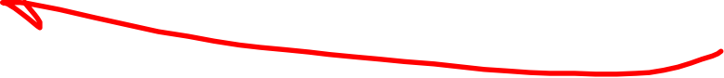
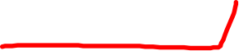















FSM: operation with no errors
rdt_send(data)
snkpkt = make_pkt(data, checksum)
udt_send(sndpkt)
rdt_rcv(rcvpkt) &&
isNAK(rcvpkt)
sender
Wait for call from above
Wait for ACK or NAK
udt_send(sndpkt)
rdt_rcv(rcvpkt) && corrupt(rcvpkt)
udt_send(NAK)
rdt_rcv(rcvpkt) && isACK(rcvpkt)
Wait for call from below
receiver
rdt_rcv(rcvpkt) && notcorrupt(rcvpkt)
extract(rcvpkt,data)
deliver_data(data)
udt_send(ACK)

Slide 16


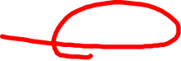


FSM: corrupted packet scenario
rdt_send(data)
snkpkt = make_pkt(data, checksum)
udt_send(sndpkt)
rdt_rcv(rcvpkt) &&
isNAK(rcvpkt)
sender
Wait for call from above
Wait for ACK or NAK
udt_send(sndpkt)
rdt_rcv(rcvpkt) && corrupt(rcvpkt)
udt_send(NAK)
rdt_rcv(rcvpkt) && isACK(rcvpkt)
Wait for call from below
receiver
rdt_rcv(rcvpkt) && notcorrupt(rcvpkt)
extract(rcvpkt,data)
deliver_data(data)
udt_send(ACK)

Slide 17
A fatal flaw!
what happens if ACK/NAK corrupted?
sender doesn’t know what happened at receiver!
can’t just retransmit: possible duplicate
handling duplicates:
sender retransmits current pkt if ACK/NAK corrupted
sender adds sequence number to each pkt
receiver discards (doesn’t deliver up) duplicate pkt
stop and wait
sender sends one packet, then waits for receiver’s response!

Slide 18
Channels with errors and loss
New channel assumption: underlying channel can also lose packets (data, ACKs)
checksum, sequence #s, ACKs, will be of help … but not quite enough
Q: How do humans handle lost sender-to-receiver words in conversation?

Slide 19

Channels with errors and loss
Approach: sender waits “reasonable” amount of time for ACK
retransmits if no ACK received in this time
if pkt (or ACK) just delayed (not lost):
retransmission will be duplicated, but seq #s already handles this!
receiver must specify seq # of packet being ACKed
use countdown timer to interrupt after “reasonable” amount of time
timeout

Slide 20




Sender FSM
rdt_send(data)
sndpkt = make_pkt(0, data, checksum)
udt_send(sndpkt)
start_timer
Wait for
call 0 from above
Wait for ACK0
rdt_rcv(rcvpkt)
&& notcorrupt(rcvpkt)
&& isACK(rcvpkt,1)
rdt_rcv(rcvpkt)
&& notcorrupt(rcvpkt)
&& isACK(rcvpkt,0)
stop_timer
stop_timer
Wait for ACK1
Wait for
call 1 from above
rdt_send(data)
sndpkt = make_pkt(1, data, checksum)
udt_send(sndpkt)
start_timer
Notes:
We see the familiar four state sender from our rdt 2.1 and 2.2 protocols. Top two states when sending packet with zero seq # and bottom two

Slide 21










In action
sender
receiver
sender
receiver
send pkt0
pkt0
send pkt0
pkt0
rcv pkt0
rcv pkt0
ack0
send ack0
ack0
send ack0
rcv ack0
rcv ack0
send pkt1
pkt1
send pkt1
pkt1
rcv pkt1
X
ack1
send ack1
loss
rcv ack1
send pkt0
pkt0
rcv pkt0
timeout
resend pkt1
ack0
send ack0
pkt1
rcv pkt1
ack1
send ack1
rcv ack1
send pkt0
pkt0
(a) no loss
rcv pkt0
ack0
send ack0
(b) packet loss

Slide 22







In action
sender
receiver
sender
receiver
send pkt0
pkt0
rcv pkt0
send pkt0
pkt0
ack0
send ack0
rcv pkt0
rcv ack0
ack0
send ack0
send pkt1
pkt1
rcv ack0
rcv pkt1
send pkt1
pkt1
send ack1
rcv pkt1
ack1
ack1
send ack1
X
timeout
resend pkt1
loss
pkt1
rcv pkt1
timeout
resend pkt1
rcv ack1
(detect duplicate)
pkt1
rcv pkt1
pkt0
send ack1
(detect duplicate)
send pkt0
ack1
send ack1
ack1
rcv pkt0
rcv ack1
rcv ack1
ack0
send ack0
send pkt0
pkt0
(ignore)
rcv pkt0
pkt1
ack0
send ack0
(c) ACK loss
(d) delayed ACK

Slide 23



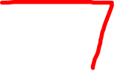
TCP segment structure
Bit 0
Bit 15
Bit 16
Bit 31
Source port (16)
Destination port (16)
Sequence number (32)
Acknowledgement number (32)
20 Bytes
Header length (4)
Reserved (6)
Code bits (6)
Window (16)
Checksum (16)
Urgent (16)
Options (0 or 32 if any)
Data (varies)

Slide 24










TCP segment structure
32 bits
source port #
dest port #
segment seq #: counting bytes of data into bytestream (not segments!)
ACK: seq # of next expected byte; A bit: this is an ACK
sequence number
acknowledgement number
length (of TCP header)
head
len
resv
C
E
U
A
P
R
S
F
receive window
flow control: # bytes receiver willing to accept
Internet checksum
checksum
Urgent data pointer
options (variable length)
C, E: congestion notification
TCP options
application
data
(variable length)
data sent by application into TCP socket
RST, SYN, FIN: connection management

Slide 25
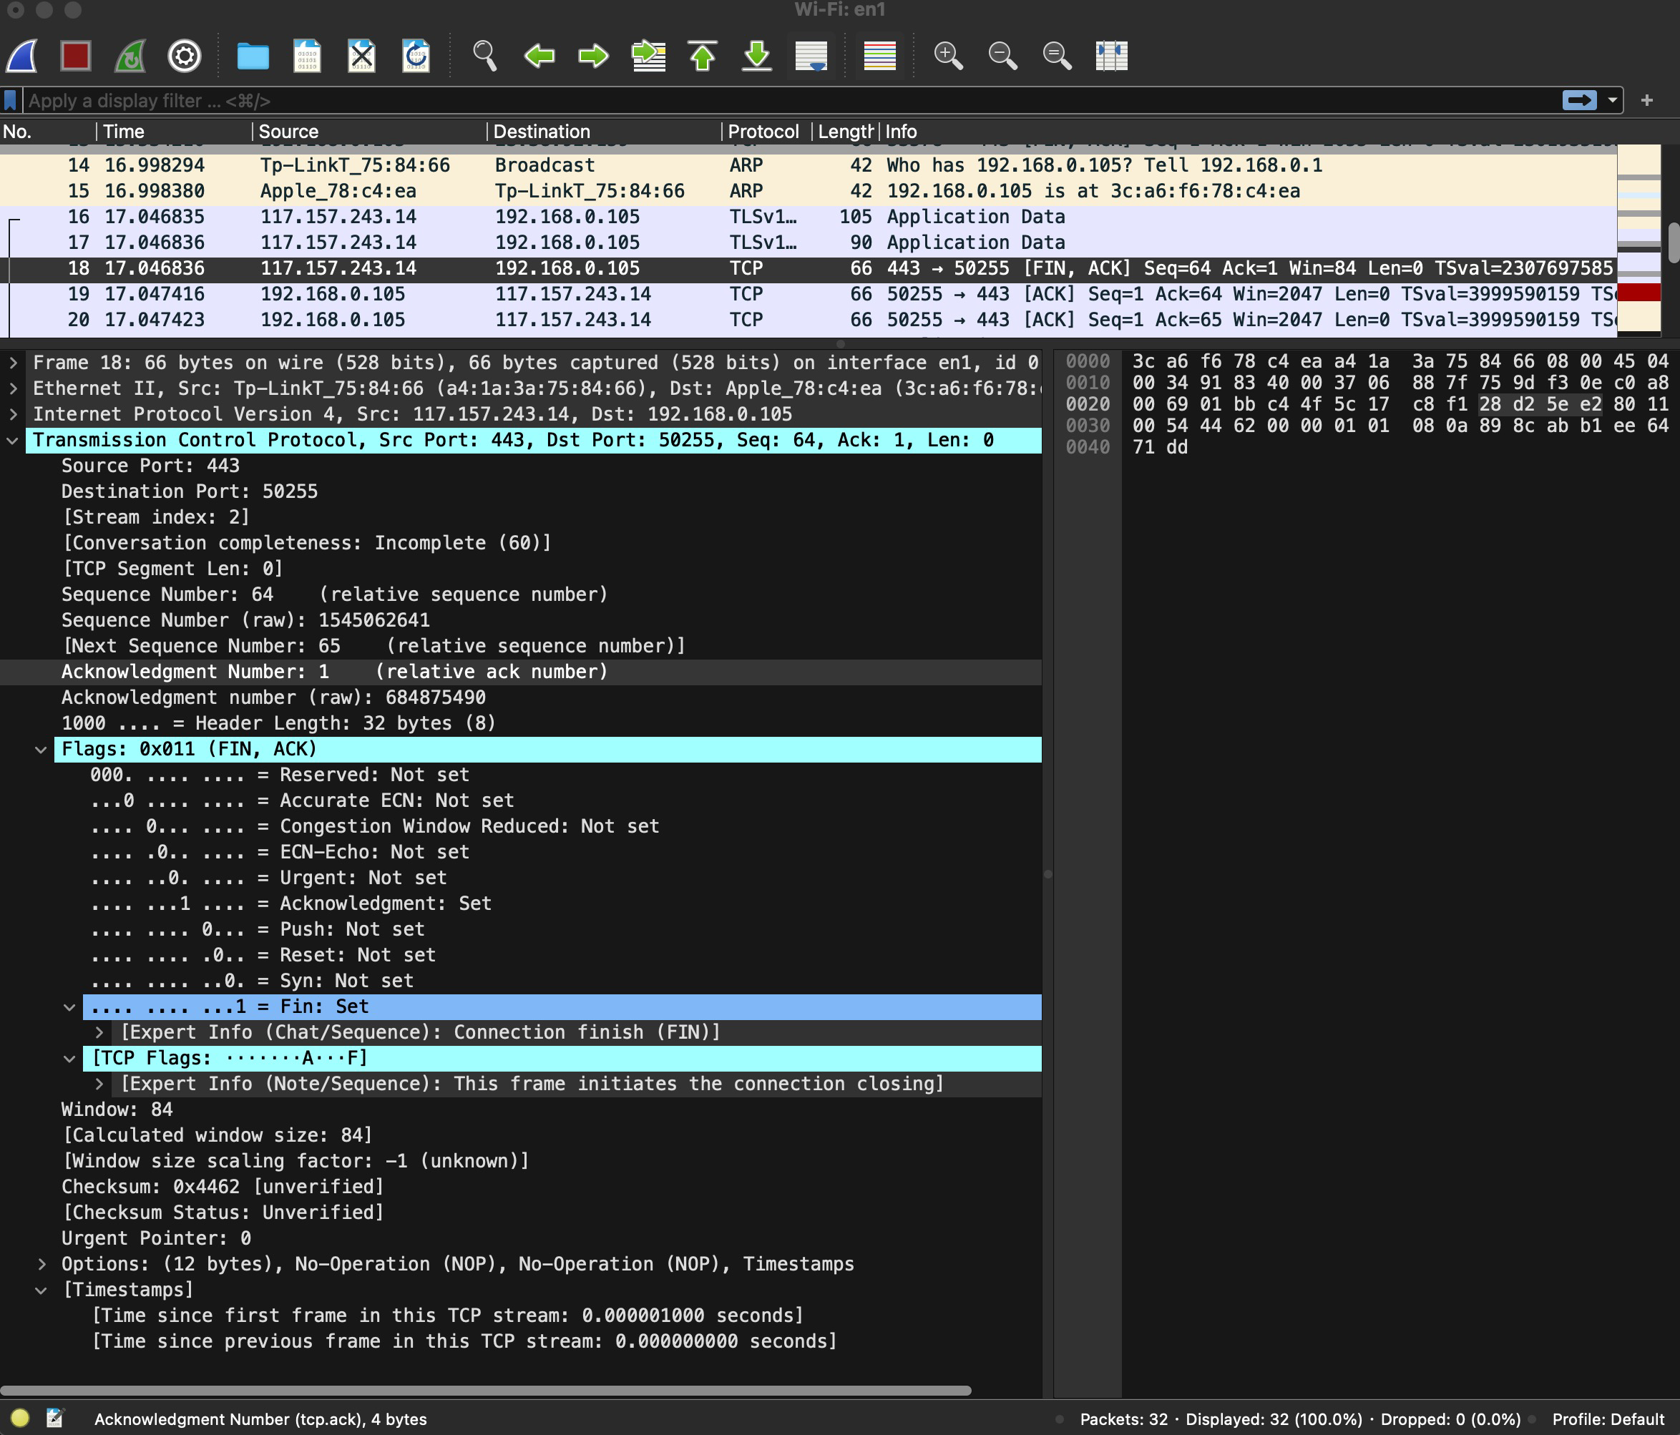
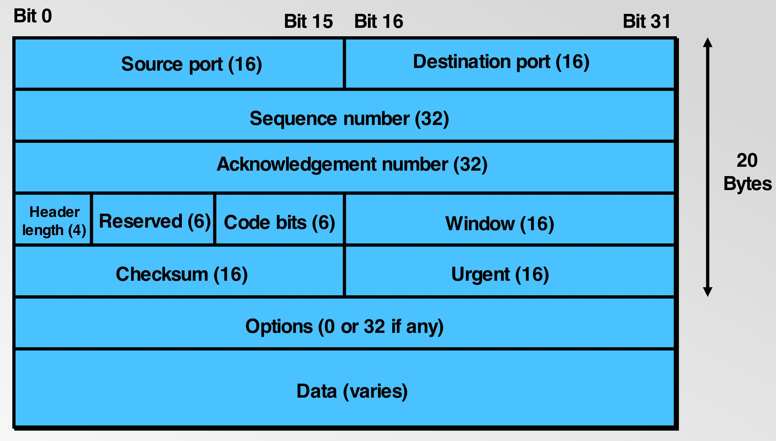

TCP segment structure via Wireshark

Slide 26










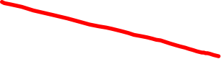
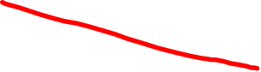




TCP round trip time, timeout
Q: how to set TCP timeout value?
longer than RTT, but RTT varies!
too short: premature timeout, unnecessary retransmissions
too long: slow reaction to segment loss
Q: how to estimate RTT?
SampleRTT:measured time from segment transmission until ACK receipt
ignore retransmissions
SampleRTT will vary, want estimated RTT “smoother”
average several recent measurements, not just current SampleRTT

Slide 27
TCP round trip time, timeout
EstimatedRTT = (1- α)*EstimatedRTT + α*SampleRTT
exponential weighted moving average (EWMA)
influence of past sample decreases exponentially fast
typical value: α = 0.125
RTT (milliseconds)
Notes:
This is how TCP re-computes the estimated RTT each time a new SampleRTT is taken.
The process is knows as an exponeitally weighted moving average, shown by the equation here.
<say it>
Where alpha reflects the influence of the most recent measurements on the estimated RTT; a typical value of alpha used in implementaitons is .125
The graph at the bottom show measured RTTs beween a host in the Massachusetts and a host in France, as well as the estimated, “smoothed” RTT

Slide 28
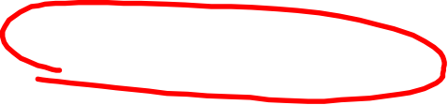


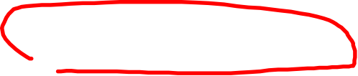
TCP round trip time, timeout
timeout interval: EstimatedRTT plus “safety margin”
large variation in EstimatedRTT: want a larger safety margin
TimeoutInterval = EstimatedRTT + 4*DevRTT
estimated RTT
“safety margin”
* Check out the online interactive exercises for more examples: http://gaia.cs.umass.edu/kurose_ross/interactive/
Notes:
Given this value of the estimated RTT, TCP computes the timeout interval to be the estimated RTT plus a “safety margin”
And the intuition is that if we are seeing a large variation in SAMPLERTT – the RTT estimates are fluctuating a lot - then we’ll want a larger savety margin
So TCP computes the Timeout interval to be the Estimated RTT plus 4 times a measure of deviation in the RTT.
The deviation in the RTT is computed as the eWMA of the difference between the most recently measured SampleRTT from the Estimated RTT

Slide 29

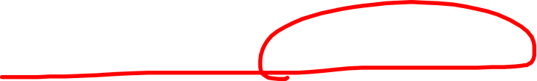
TCP connection management
before exchanging data, sender/receiver “handshake”:
agree to establish connection (each knowing the other willing to establish connection)
agree on connection parameters (e.g., starting seq #s)
application
application
connection state: ESTAB
connection variables:
seq # client-to-server
server-to-client
rcvBuffer size
at server,client
connection state: ESTAB
connection Variables:
seq # client-to-server
server-to-client
rcvBuffer size
at server,client
network
network
Socket clientSocket =
newSocket("hostname","port number");
Socket connectionSocket = welcomeSocket.accept();
Notes:
The other TCP topic we’ll want to consider here is that of “connection management”
The TCP sender and reciver have a number of pieces of shared state that they must establish before actually communication
FIRST theym ust both agree that they WANT to communicate with each other
Secondly there are connection parameters – the initial sequence number and the initial receiver-advertised bufferspace that they’ll want to agree on
This is done via a so-called handshake protocol – the client reaching our to the server, and the server answering back.
And before diving into the TCP handshake protocol, let’s first consider the problem of handshaking, of establishing shared state.

Slide 30
Client/Server (C/S) mode
Network communication interface：C/S mode (handshake)
The client sends a service request to the server, and the server waits to receive the service request, and responds and services according to its own resource status.
TCP protocol: The client process first sends a connection request to the server process, and establishes the connection through 3-way handshakes. After communication, either party can release the connection through four handshakes.
UDP protocol: The client process must first actively send service requests (data) to the server process, and then the server can send replies to the client process.

Slide 31





Agreeing to establish a connection
2-way handshake (Alice talks to Bob):
Q: will 2-way handshake always work in network?
variable delays
retransmitted messages (e.g. req_conn(x)) due to message loss
message reordering
can’t “see” other side
Let’s talk
ESTAB
OK
ESTAB
For a network protocol:
choose x
req_conn(x)
ESTAB
acc_conn(x)
ESTAB
Notes:
Here’s an example of a two way handshake. Alice reaches out to Bob and say’s “let’s talk” and Bob says OK, and they start their conversation
For a network protocol, the equivalent protocol would be a client sending a “request connection” message saying ”let’s talk, the initial sequence number is x”
And the server would respond with a message ”I accept your connect x”
And the question we want to ask ourselves is <talk through>
Will this work? Let’s look at a few scenarios…

Slide 32





2-way handshake scenarios
choose x
req_conn(x)
choose x
req_conn(x)
The request message
arrives very late...
ESTAB
acc_conn(x)
ESTAB
Client terminates!
ESTAB
data(x+1)
acc_conn(x)
The server believes the connection
has been established..
accept
data(x+1)
ACK(x+1)
connection
x completes
connection
x incompletes
so 2-way handshake doesn’t work!
No problem!
Problem occurs!

Slide 33

A human 3-way handshake protocol
1. On belay?
2. Belay on.
3. Climbing.
Notes:
As usual, there’s a human protocol analogy to the three way handshake, and I still remember thinking about this clinging for my life while climbing up a rockface
When you want start climbing you first say ON BELOW (meaning ARE YOU READY WITH MY SAFETY ROPE)
THE BELYER (server) responds BELAY ON (that lets you know the belayer is ready for you)
And then you say CLIMING
It’s amazing what can pass through your head when your clinging for your life o a

Slide 34














TCP 3-way handshake - establishment
Server state
Client state
serverSocket = socket(AF_INET,SOCK_STREAM)
serverSocket.bind((‘’,serverPort))
serverSocket.listen(1)
connectionSocket, addr = serverSocket.accept()
clientSocket = socket(AF_INET, SOCK_STREAM)
LISTEN
clientSocket.connect((serverName,serverPort))
LISTEN
choose init seq num, x
send TCP SYN msg
SYNbit=1, Seq=x
SYNSENT
choose init seq num, y
send TCP SYNACK
msg, acking SYN
SYNbit=1, Seq=y
ACKbit=1; ACKnum=x+1
SYN RCVD
received SYNACK(x)
indicates server is live;
send ACK for SYNACK;
this segment may contain
client-to-server data
ESTAB
ACKbit=1, ACKnum=y+1
Seq=x+1
received ACK(y)
indicates client is live
ESTAB
Notes:
TCP’s three way handshake, that operates as follows
Let’s say the client and server both create a TCP socket as we learned about in Chapter 2 and enter the LISTEN state
The client then connects to the server sending a SYN message with a sequence number x (SYN Message is an TCP Segment with SYN but set in the header – you might want to go back and review the TCP segment format!)
The server is waiting for a connection, and receives the SYN message enters the SYN received state (NOT the established state and sends a SYN ACK message back.
Finally the client sends an ACK message to the server, and when the server receiver this enters the ESTABLished state. This is when the application process would see the return from the wait on the socket accept() call

Slide 35


TCP 3-way handshake analysis via Wireshark
Step1: run your wireshark, click the capture button
Step2: start your web browser, enter a web address, e.g.,
http://gaia.cs.umass.edu/wireshark-labs/INTRO-wireshark-file1.html
Step3: wait for a while and then click the stop button
Step4: type “TCP” in the filter of wireshark, find the 3-way handshake
Notes:
TCP’s three way handshake, that operates as follows
Let’s say the client and server both create a TCP socket as we learned about in Chapter 2 and enter the LISTEN state
The client then connects to the server sending a SYN message with a sequence number x (SYN Message is an TCP Segment with SYN but set in the header – you might want to go back and review the TCP segment format!)
The server is waiting for a connection, and receives the SYN message enters the SYN received state (NOT the established state and sends a SYN ACK message back.
Finally the client sends an ACK message to the server, and when the server receiver this enters the ESTABLished state. This is when the application process would see the return from the wait on the socket accept() call

Slide 36
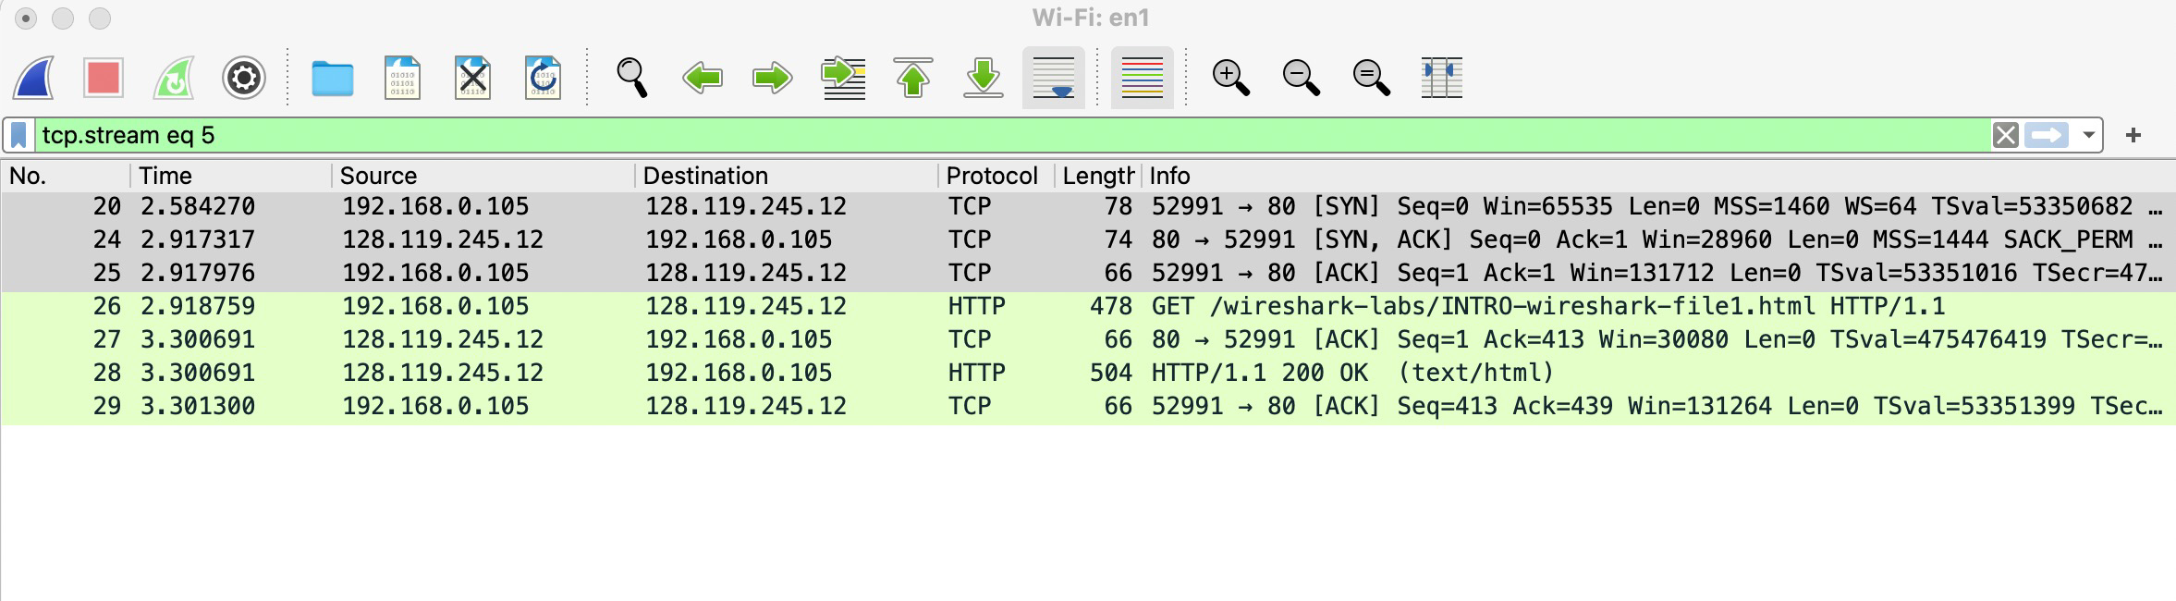
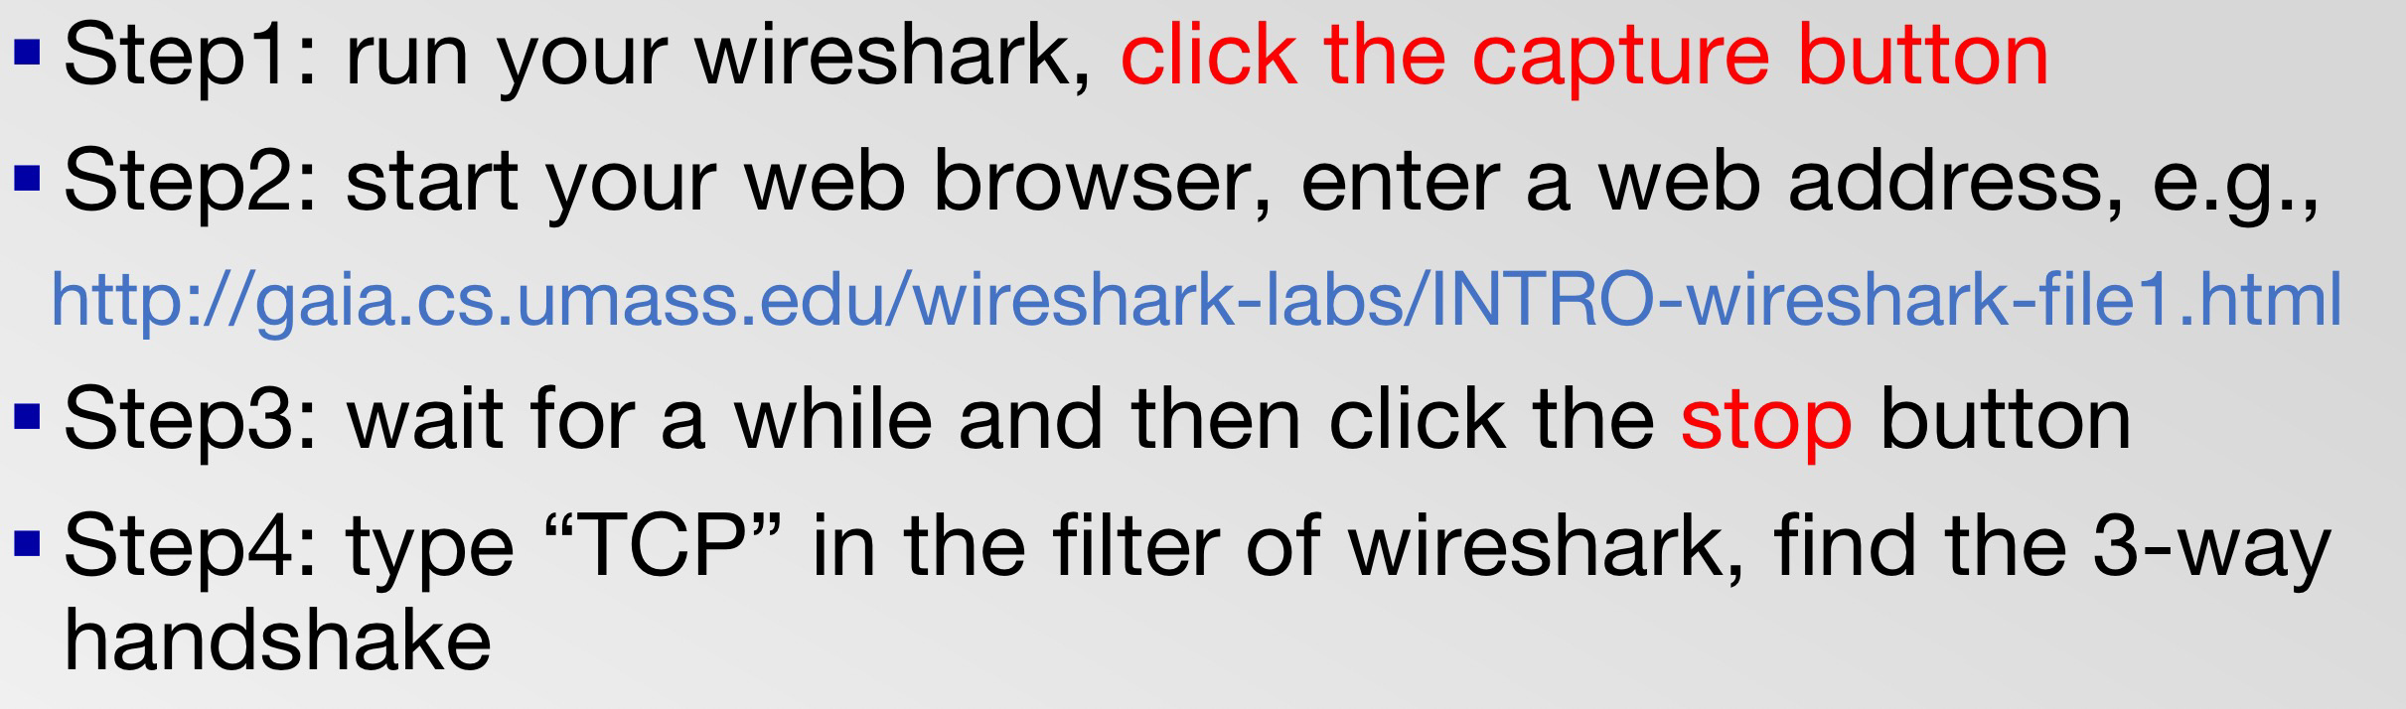

TCP 3-way handshake analysis via Wireshark
3-way handshake:
(client) SYN - (server) SYN ACK - (client) ACK
Try on your computer and see what happens! (5mins)
Notes:
TCP’s three way handshake, that operates as follows
Let’s say the client and server both create a TCP socket as we learned about in Chapter 2 and enter the LISTEN state
The client then connects to the server sending a SYN message with a sequence number x (SYN Message is an TCP Segment with SYN but set in the header – you might want to go back and review the TCP segment format!)
The server is waiting for a connection, and receives the SYN message enters the SYN received state (NOT the established state and sends a SYN ACK message back.
Finally the client sends an ACK message to the server, and when the server receiver this enters the ESTABLished state. This is when the application process would see the return from the wait on the socket accept() call

Slide 37
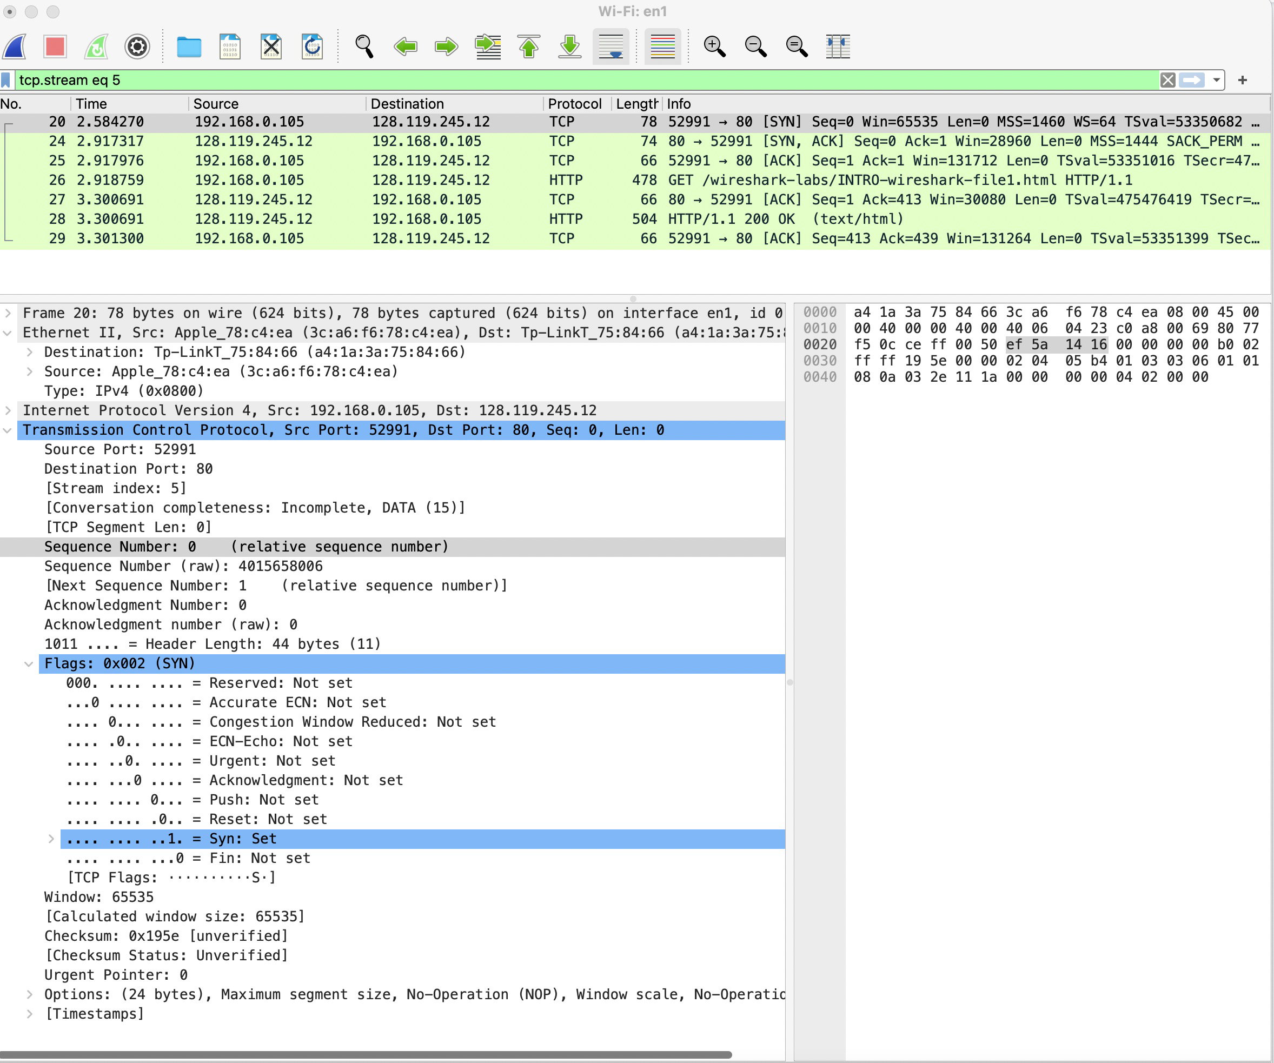
TCP 3-way handshake analysis via Wireshark
(client) SYN:
Flag = SYN
Seq. No = 0;
Notes:
TCP’s three way handshake, that operates as follows
Let’s say the client and server both create a TCP socket as we learned about in Chapter 2 and enter the LISTEN state
The client then connects to the server sending a SYN message with a sequence number x (SYN Message is an TCP Segment with SYN but set in the header – you might want to go back and review the TCP segment format!)
The server is waiting for a connection, and receives the SYN message enters the SYN received state (NOT the established state and sends a SYN ACK message back.
Finally the client sends an ACK message to the server, and when the server receiver this enters the ESTABLished state. This is when the application process would see the return from the wait on the socket accept() call

Slide 38
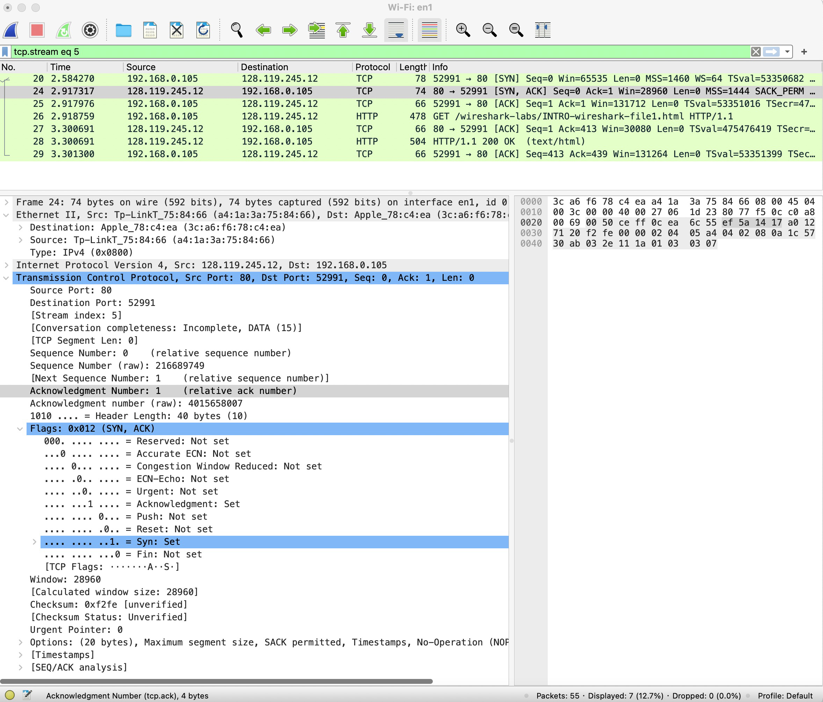
TCP 3-way handshake analysis via Wireshark
(server) SYN ACK:
Flag = SYN ACK
Seq. No = 0;
ACK No = 1;
Notes:
TCP’s three way handshake, that operates as follows
Let’s say the client and server both create a TCP socket as we learned about in Chapter 2 and enter the LISTEN state
The client then connects to the server sending a SYN message with a sequence number x (SYN Message is an TCP Segment with SYN but set in the header – you might want to go back and review the TCP segment format!)
The server is waiting for a connection, and receives the SYN message enters the SYN received state (NOT the established state and sends a SYN ACK message back.
Finally the client sends an ACK message to the server, and when the server receiver this enters the ESTABLished state. This is when the application process would see the return from the wait on the socket accept() call

Slide 39
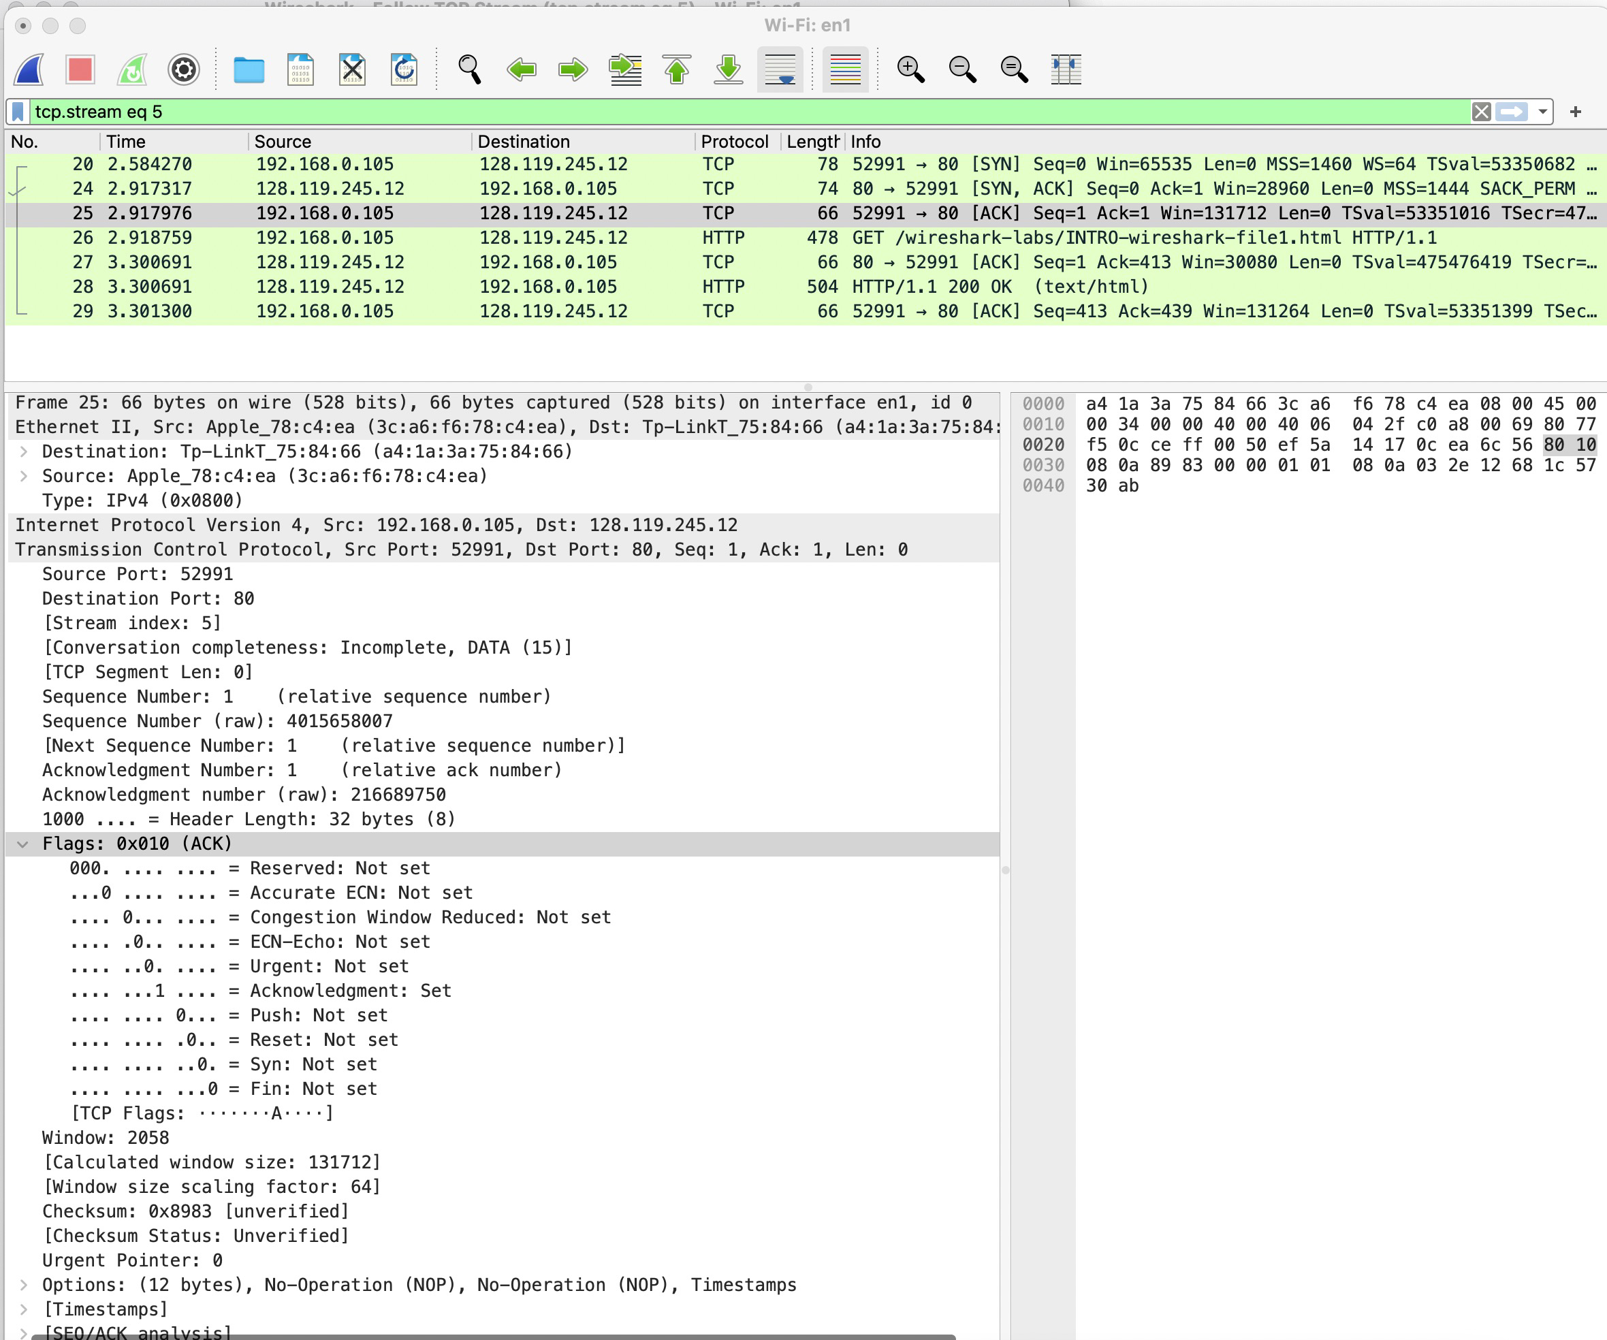
TCP 3-way handshake analysis via Wireshark
(client) ACK:
Flag = ACK;
Seq. No = 1;
ACK No = 1;
Notes:
TCP’s three way handshake, that operates as follows
Let’s say the client and server both create a TCP socket as we learned about in Chapter 2 and enter the LISTEN state
The client then connects to the server sending a SYN message with a sequence number x (SYN Message is an TCP Segment with SYN but set in the header – you might want to go back and review the TCP segment format!)
The server is waiting for a connection, and receives the SYN message enters the SYN received state (NOT the established state and sends a SYN ACK message back.
Finally the client sends an ACK message to the server, and when the server receiver this enters the ESTABLished state. This is when the application process would see the return from the wait on the socket accept() call

Slide 40
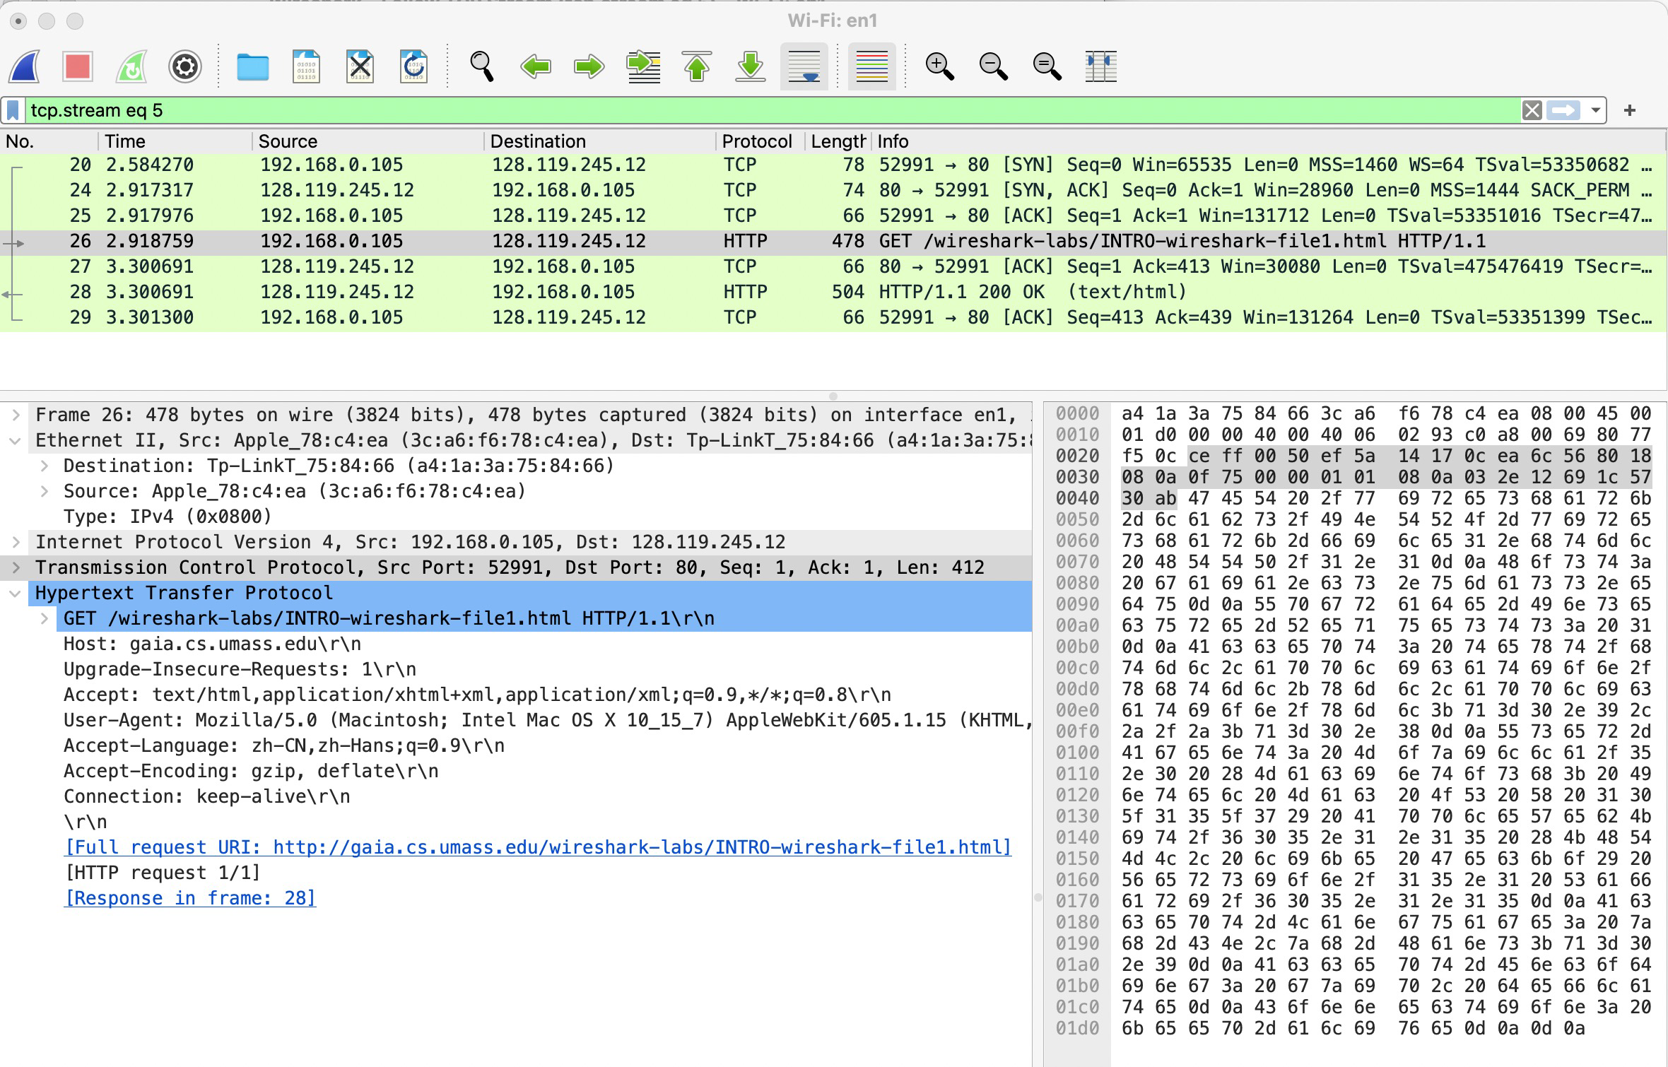
TCP 3-way handshake analysis via Wireshark
After 3-way handshake, the TCP connection has been established successfully!
Notes:
TCP’s three way handshake, that operates as follows
Let’s say the client and server both create a TCP socket as we learned about in Chapter 2 and enter the LISTEN state
The client then connects to the server sending a SYN message with a sequence number x (SYN Message is an TCP Segment with SYN but set in the header – you might want to go back and review the TCP segment format!)
The server is waiting for a connection, and receives the SYN message enters the SYN received state (NOT the established state and sends a SYN ACK message back.
Finally the client sends an ACK message to the server, and when the server receiver this enters the ESTABLished state. This is when the application process would see the return from the wait on the socket accept() call

Slide 41
Closing a TCP: 4-way handshake
Close can be initiated by client or server!
client, server each close their side of connection
send TCP segment with FIN bit = 1
respond to received FIN with ACK
on receiving FIN, ACK can be combined with own FIN
simultaneous FIN exchanges can be handled
client state
server state
clientSocket.close()
FINbit=1, ACKbit=1; seq=x
can no longer
send but can
receive data
ACKbit=1; ACKnum=x+1
can still
send data
wait for server
close
FINbit=1, ACKbit=1; seq=y
can no longer
send data
ACKbit=1; ACKnum=y+1
Notes:
All good things must come to an end, and that’s true for a TCP connection as well.
And of course there’s a protocol for one side to gracefully close of a TCP connection using a FIN message, to which the other side sends a FINACK message and waits around a bit to respond to any retransmitted FIN messages before timing out.

Slide 42

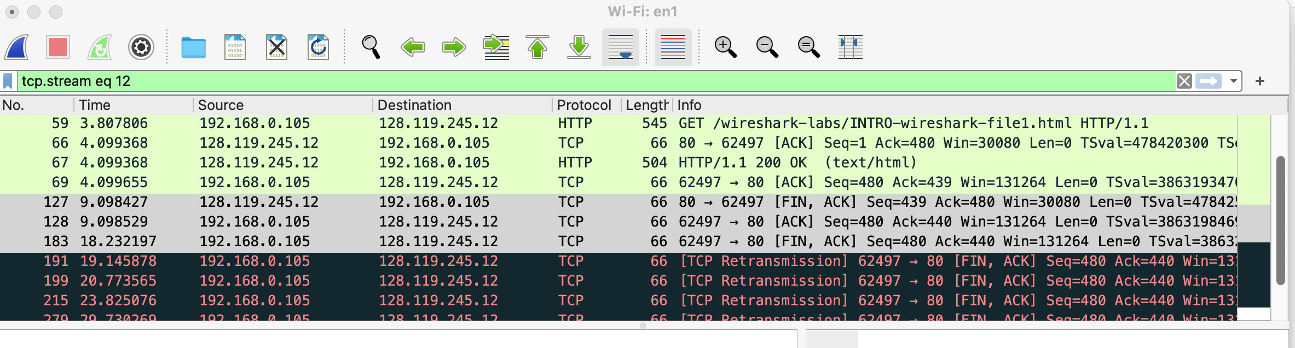
4-way handshake analysis via wireshark
FIN, ACK - ACK - FIN, ACK - ACK
Initiated by the server in this case !
Try on your computer and see what is the difference? (7mins)

Slide 43
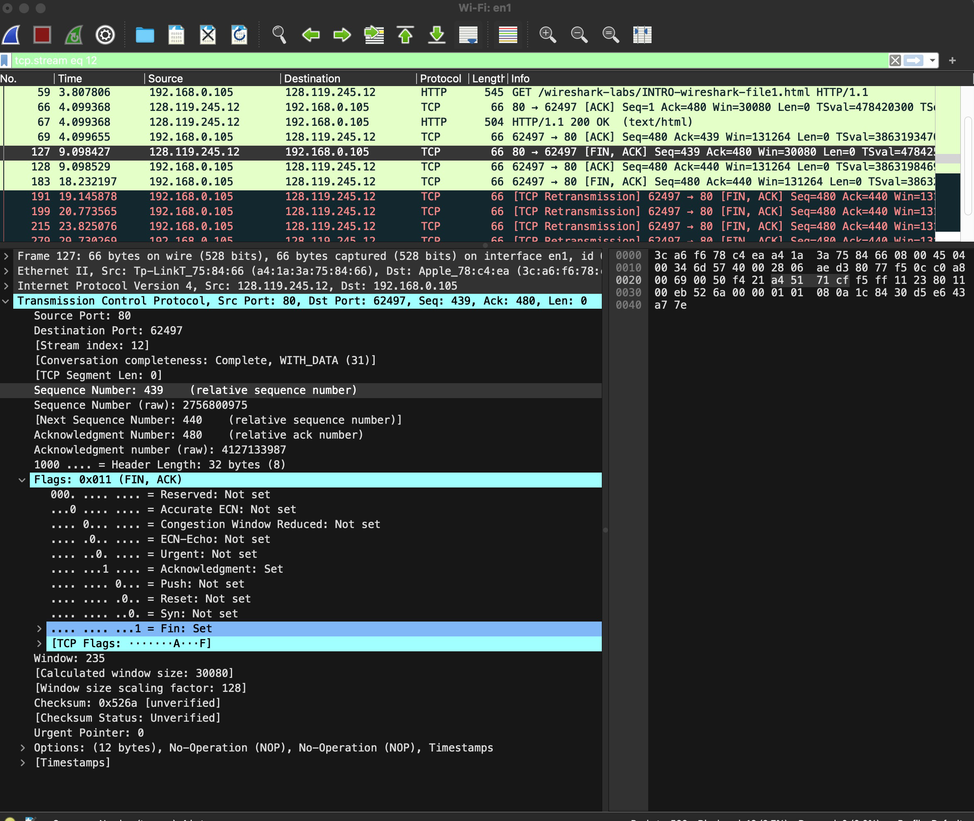
4-way handshake analysis via wireshark
FIN,ACK (Server)
Seq. No = 439;
ACK No = 480

Slide 44
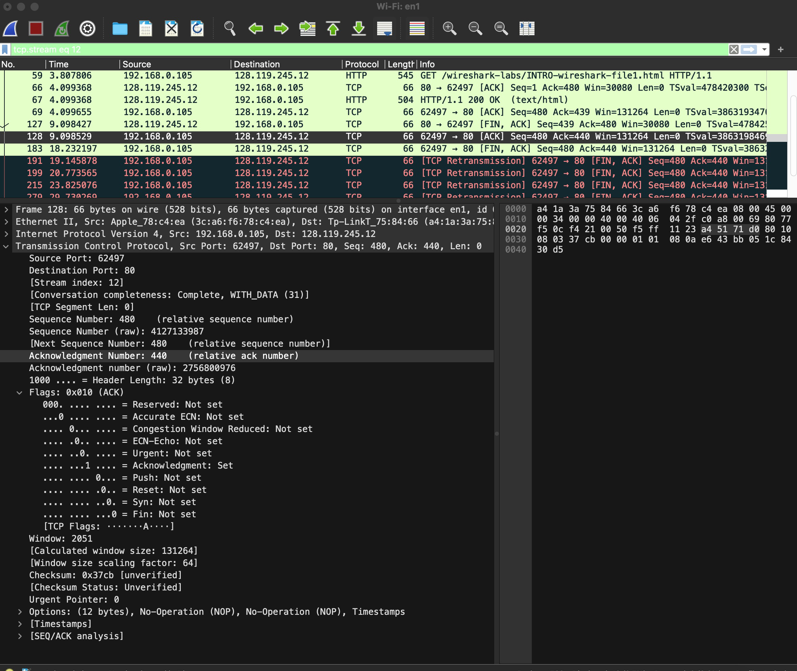
4-way handshake analysis via wireshark
ACK (Client)
Seq. No = 480;
ACK No = 440

Slide 45
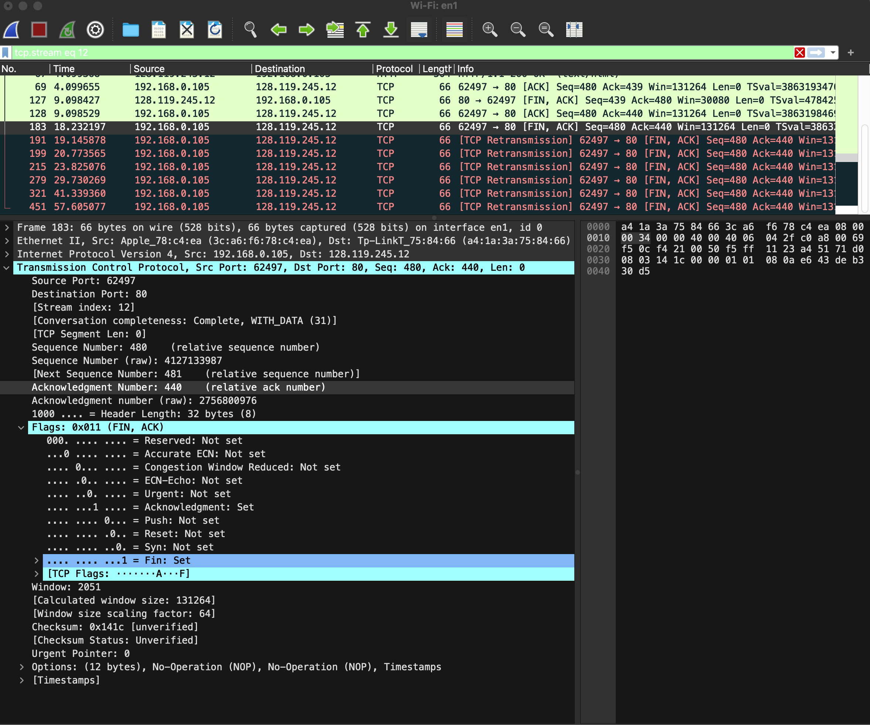
4-way handshake analysis via wireshark
FIN, ACK (Client)
Seq. No = 480;
ACK No = 440

Slide 46
4-way handshake analysis via wireshark
ACK (Server)
ACK No = ?
I didn’t capture the last ACK.
client state
server state
clientSocket.close()
FINbit=1, ACKbit=1; seq=x
can no longer
send but can
receive data
ACKbit=1; ACKnum=x+1
can still
send data
wait for server
close
FINbit=1, seq=y
can no longer
send data
ACKbit=1; ACKnum=y+1

Slide 47
Goals
1. TCP Communications
2. Socket API
3. TCP via socket API

Slide 48

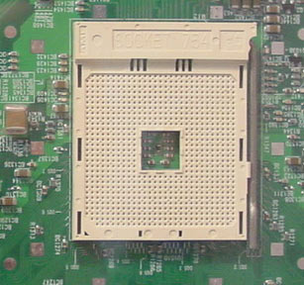
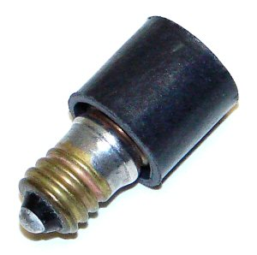
Sockets
Various sockets… Any similarity?
Endpoint of a connection
Identified by IP address and Port number
Primitive to implement high-level networking interfaces
e.g., Remote procedure call (RPC)

Slide 49
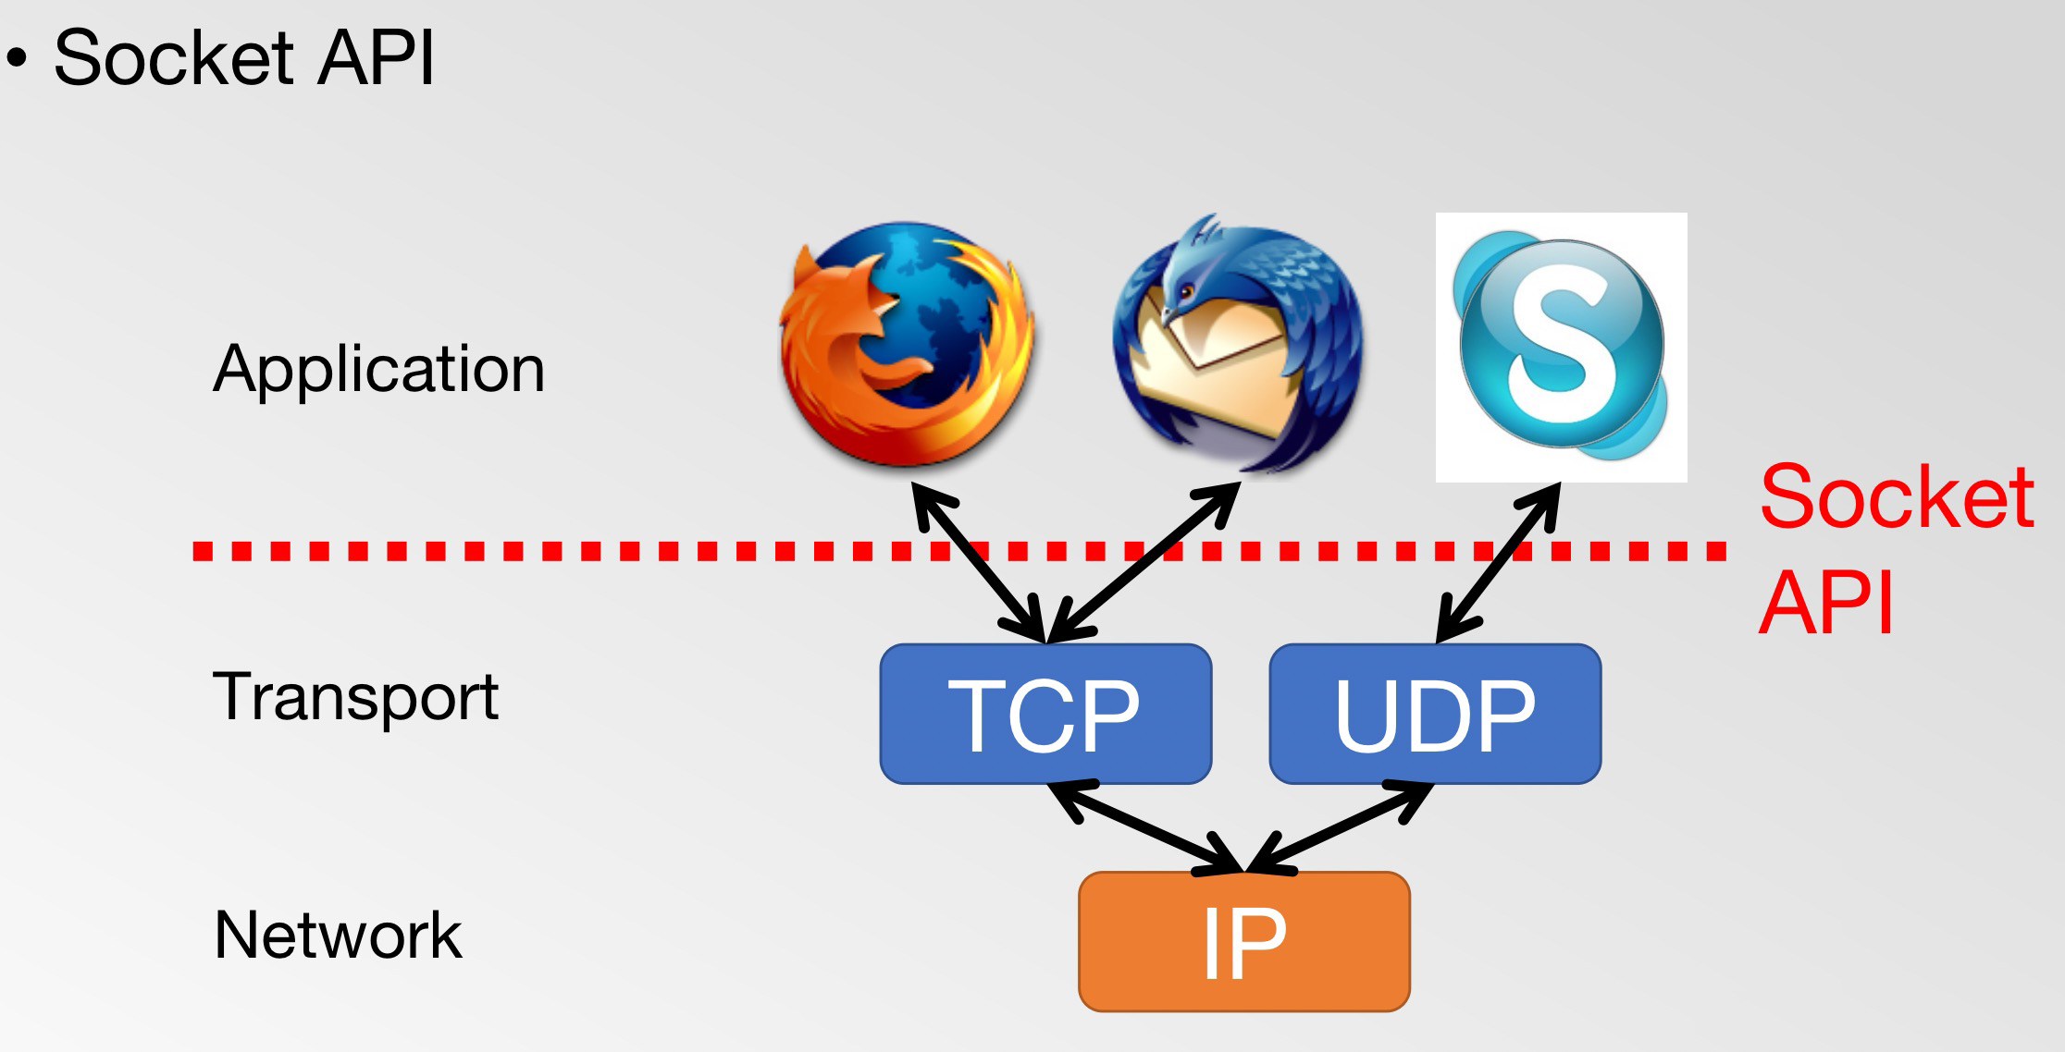
Application programming interface (API)
In order to facilitate the communication between network processes using TCP/UDP, the transport layer provides a set of programming interfaces to the application layer - Socket API.

Slide 50
Types of Sockets
Stream socket (aka TCP)
Datagram socket (aka UDP)
Connection-oriented
Requires connection establishment & termination
Reliable delivery
In-order delivery
Retransmission
No duplicates
High variance in latency
Cost of the reliable service
File-like interface (streaming)
E.g., HTTP, FTP, …
Connection-less
“Best-effort” delivery
Arbitrary order of packet delivery
No retransmission
Possible duplicates
Low variance in latency
Packet-like interface
Requires packetizing
E.g., DNS, VoIP, …

Slide 51

Types of Sockets (cont’d)
When sending “Hi!” and “Hope you’re well”
TCP treats them as a single bytes stream
UDP treats them as separate messages
Bytes stream
l
l
e
w
…
e
p
o
H
!
i
H
Hope you’re well
Hi!

Slide 52
Types of Sockets (cont’d)
Thus, TCP needs application-level message boundary.
By carrying length in application-level header
E.g.
struct my_app_hdr {
int length
}
Bytes stream
l
l
e
w
…
o
H
16
!
i
H
3

Slide 53
Socket API
Socket programming interface API：
creat socket：socket( )
bind the local address：bind( ) – for server side
establish socket connection：connect( )
receive connection request：listen( ) 、accept( )
send data：send( ) / sendto( )
receive data：recv( ) / recvfrom( )

Slide 54
Goals
1. TCP Communications
2. Socket API
3. TCP via socket API

Slide 55
Socket API of TCP
Server
socket( )
Client
socket( )
bind( )
Service request
Connect()
listen( )
accept()
data sending
recv( )
send( )
data reply
send( )
recv( )
close ( )
close( )

Slide 56
Scenario #1 – TCP client-server
Sequence of actions - Initialization
Client
Server
socket()
socket()
Initialization
bind()
listen()
Connection
Establishment
connect()
accept()
send() or write()
recv() or read()
Data transfer
…
…
recv() or read()
send() or write()
Termination
Time
close()
close()

Slide 57
Initialization: server + client, socket()
sockid＝socket(af，type，protocol)
af: address family; type: transmission layer protocol type;
protocol: network communication protocol
int sock = socket(AF_INET, SOCK_STREAM, IPPROTO_IP);
if (sock < 0) {
perror(“socket() failed”);
abort();
}
socket(): returns a socket descriptor
AF_INET: IPv4 address family. (also OK with PF_INET)
C.f. IPv6 => AF_INET6
SOCK_STREAM: streaming socket type (for connected data streaming)
C.f. SOCK_DGRAM (for unconnected datagram)
perror(): prints out an error message

Slide 58
Initialization: server, bind()
bind() - for the server side
Bind the server process ID (IP address+port number) to the created socket
Only one process can bind a particular port number at a time.
bind(sockid，Servaddr，addrlen)
sockid: socket ID。
Servaddr: address of the structure socketaddr_in
addrlen: length of the socket address

Slide 59
Initialization: server, bind()
struct sockaddr_in sin;
memset(&sin, 0, sizeof(sin));
sin.sin_family = AF_INET;
sin.sin_addr.s_addr = INADDR_ANY;
sin.sin_port = htons(server_port);
if (bind(sock, (struct sockaddr*) &sin, sizeof(sin)) < 0) {
perror(“bind failed”);
abort();
}
struct sockaddr_in: Ipv4 socket address structure. (c.f., struct sockaddr_in6)
INADDR_ANY: If server has multiple IP addresses, binds any address.
htons(): converts host byte order into network byte order.
bind(sockid，Servaddr，addrlen)

Slide 60
Initialization: server, listen
The server process using TCP protocol generally waits for the connection request of the client process on a well-known port.
The server process is usually listening(). Once a connection request comes, the server process wakes up and processes the connection request of the client process.

Slide 61
Initialization: server, listen()
Socket is active, by default
We need to make it passive to get connections.
if (listen(sock, back_log) < 0) {
perror(“listen failed”);
abort();
}
listen(): converts an active socket to passive
back_log: connection-waiting queue size. (e.g., 32)
Busy server may need a large value (e.g., 1024, …)

Slide 62
Scenario #1 – TCP client-server
Sequence of actions - Connection Est.
Client
Server
socket()
socket()
Initialization
bind()
listen()
Connection
Establishment
connect()
accept()
send() or write()
recv() or read()
Data transfer
…
…
recv() or read()
send() or write()
Termination
Time
close()
close()

Slide 63
Connection Establishment: server, connect()
The client process using TCP protocol communication actively requests to establish a connection with the server by calling connect ();
connect(sockid, Seraddr, Serveraddrlen)
Sockid：local socket ID。
Seraddr：a pointer to the socket address structure of the server (including IP address, port and other information)。
Seraddrlen：length of the server socket address structure.

Slide 64
Connection Establishment: server, connect()
connect(): used for TCP client sockaddr_in Seraddr; Seraddr. sin_family = AF_INET; Seraddr. sin_port=htons(5050); Seraddr. sin_addr.s_addr= inet_addr(“20.22.68.5") int nResult=connect(sockid,(sockaddr*)&Seraddr,sizeof(sockaddr)); if(nResult==SOCKET_ERROR) { //error processing }

Slide 65
Connection Establishment: server, accept()
accept( )：The server process handles the connection request of the client process;
When there is no connection request in the waiting queue, the service process is listening. Otherwise, it responds to and processes the connection request:
newsock = accept（sockid，clientaddr，addrlen）
Sockid：local socket ID。
clientadd: The pointer to the client socket address structure. The initial value is null. When the accept call returns, the client process's socket address is filled into this address structure
addrlen: The initial value is 0. When the accept call returns, it stores the length of the client socket address.
Example： sockaddr_in clientaddr; SOCKET newsockid = accept(sockid,(sockaddr*)&clientaddr,sizeof(sockaddr)) if(newsockid==INVALID_SOCKET) {
//error processing
}

Slide 66
Connection Establishment: server, accept()
struct sockaddr_in client_sin;
int addr_len = sizeof(client_sin);
int client_sock = accept(listening_sock,
(struct sockaddr *) &client_sin,
&addr_len);
if (client_sock < 0) {
perror(“accept failed”);
abort();
}
accept(): returns a new socket descriptor for a client connection in the connection-waiting queue.
This socket descriptor is to communicate with the client
The passive socket (listening_sock) is not to communicate with a client
client_sin: contains client IP address and port number

Slide 67
Scenario #1 – TCP client-server
Sequence of actions - Data transfer
Client
Server
socket()
socket()
Initialization
bind()
listen()
Connection
Establishment
connect()
accept()
send() or write()
recv() or read()
Data transfer
…
…
recv() or read()
send() or write()
Termination
Time
close()
close()

Slide 68
Sending Data: server+client, send()
send(sockid, buf, buflen, flags)
char *data_addr = “hello, world”;
int data_len = 12;
int sent_bytes = send(sock, data_addr, data_len, 0);
if (sent_bytes < 0) {
perror(“send failed”);
}
send(): sends data, returns the number of sent bytes
data_addr: address of data to send
data_len: size of the data
With blocking sockets (default), send() blocks until it sends all the data.
With non-blocking sockets, sent_bytes may not equal to data_len
If kernel does not have enough space, it accepts only partial data
You must retry for the unsent data

Slide 69
Receiving Data: server+client, recv()
recv(sockid, buf, buflen, flags)
char buffer[4096];
int expected_data_len = sizeof(buffer);
int read_bytes = recv(sock, buffer, expected_data_len, 0);
if (read_bytes == 0) { // connection is closed
…
} else if (read_bytes < 0) { // error
perror(“recv failed”);
} else { // OK. But no guarantee read_bytes == expected_data_len
…
}
recv(): reads bytes from the socket and returns the number of read bytes.
read_bytes may not equal to expected_data_len
If no data is available, it blocks
If only partial data is available, read_bytes < expected_data_len
On socket close, expected_data_len equals to 0 (not error!)
If you get only partial data, you should retry for the remaining portion.

Slide 70
Termination: server+client, close()
// after use the socket
close(socketid);
close(): closes the socket descriptor

Slide 71
TCP Socket Summary
Client
Server
Client
socket()
connect()
Server
socket()
bind()
listen()
accept()
Initialization
socket()
socket()
bind()
listen()
Connection
Establishment
connect()
accept()
Data transfer
send() or write()
recv() or read()
…
…
recv() or read()
send() or write()
Termination
Time
close()
close()

Slide 72
Scenario #2 – UDP client-server
Sequence of actions: what’s the difference comapred to TCP??
Client
Server
socket()
socket()
Initialization
bind()
listen()
Don’t need
this step!!
Why??
Connection
Establishment
connect()
accept()
send() or write()
recv() or read()
Data transfer
…
…
recv() or read()
send() or write()
Termination
Time
close()
close()

Slide 73
Scenario #2 – UDP client-server
Use sendto() and recvfrom() instead of send() and recv()
Client
Server
socket()
socket()
Initialization
bind()
sendto()
recvfrom()
Data transfer
…
…
recvfrom()
sendto()
Termination
Time
close()
close()

Slide 74
Send Data Over UDP: sendto()
struct sockaddr_in sin;
memset(&sin, 0, sizeof(sin));
sin.sin_family = AF_INET;
sin.sin_addr.s_addr = inet_addr(“128.32.132.214”);
sin.sin_port = htons(1234);
sent_bytes = sendto(sock, data, data_len, 0,
(struct sockaddr *) &sin, sizeof(sin));
if (sent_bytes < 0) {
perror(“sendto failed”);
abort();
}
sendto(): sends a packet to a specific destination address and port
As opposed to TCP, UDP packetizes data. So, sendto() sends all data or nothing.

Slide 75
Receive Data Over UDP: recvfrom()
struct sockaddr_in sin;
int sin_len;
char buffer[4096];
int read_bytes = recvfrom(sock, buffer, sizeof(buffer), 0, (struct sockaddr *) &sin, &sin_len);
if (read_bytes < 0) {
perror(“recvfrom failed”);
abort();
}
recvfrom(): reads bytes from the socket and sets the source information
Reading 0 bytes does not mean “connection closed” unlike TCP.

Slide 76
TCP Socket API Summary
Socket API | Protocol | Server/Client
SOCKET socket( int af, int type, int protocol ); int bind( SOCKET s, const struct sockaddr FAR * seradd, int seraddlen ) int listen(SOCKET s, int quelen ) SOCKET accept( SOCKET s, struct sockaddr FAR * cliaddr, int FAR * cliaddrlen ) int connect(SOCKET s, const struct sockaddr FAR * seradd, int seraddlen ) int send(SOCKET s, const char FAR * buf, int len, int flags ) int recv( SOCKET s, char FAR * buf, int len, int flags ) int close( SOCKET s ) | TCP TCP TCP TCP TCP TCP TCP TCP | S/C S S S C S/C S/C S/C

Slide 77
UDP Socket API Summary
Socket API | Protocol | Server/Client
SOCKET socket( af, type, protocol ); int bind( SOCKET s, const struct sockaddr FAR * seradd, int seraddlen ) int sendto（sockid，buf，buflen，flags， destadd，addrlen） int recvfrom（sockid，buf，buflen，flags， suradd，suraddrlen） int close( SOCKET s ) | UDP UDP UDP UDP UDP | S/C S S/C S/C S/C

Slide 78
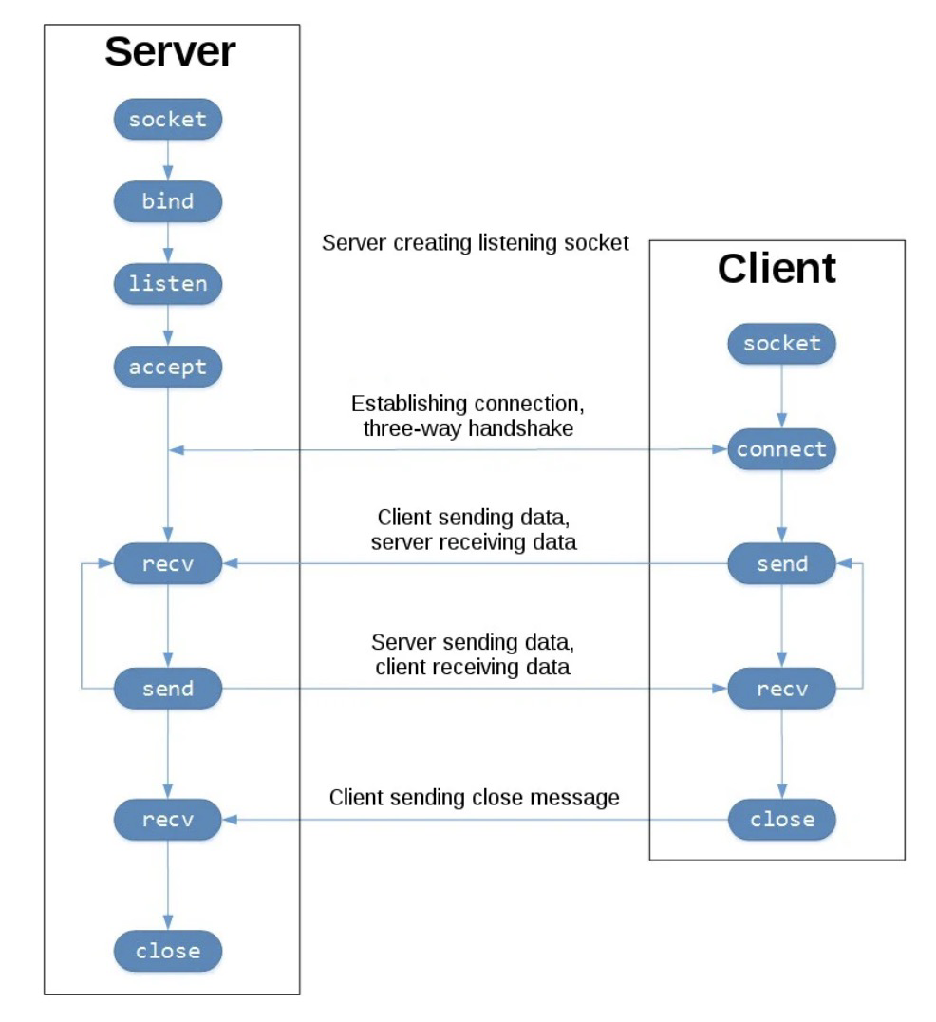
Example - TCP socket flow

Slide 79
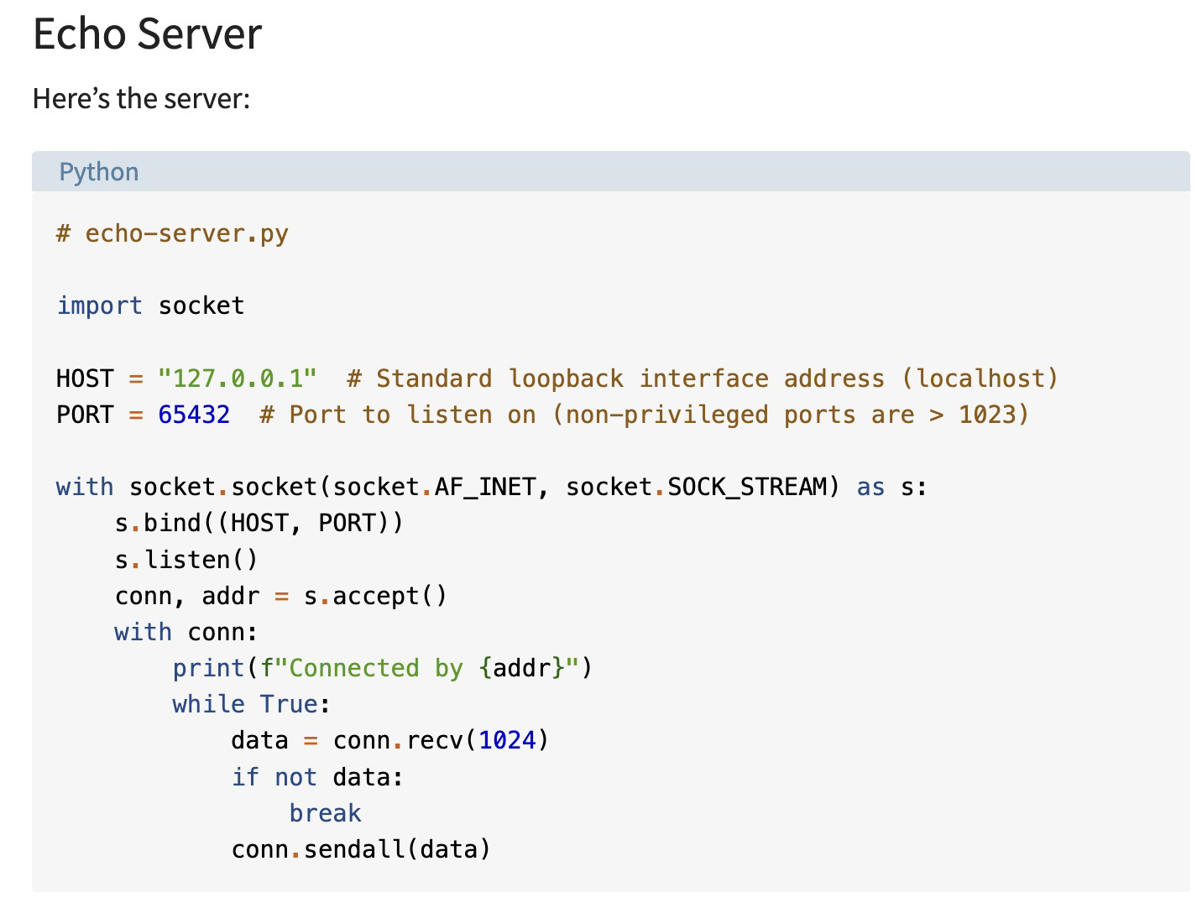
Example - TCP socket flow
https://realpython.com/python-sockets/

Slide 80
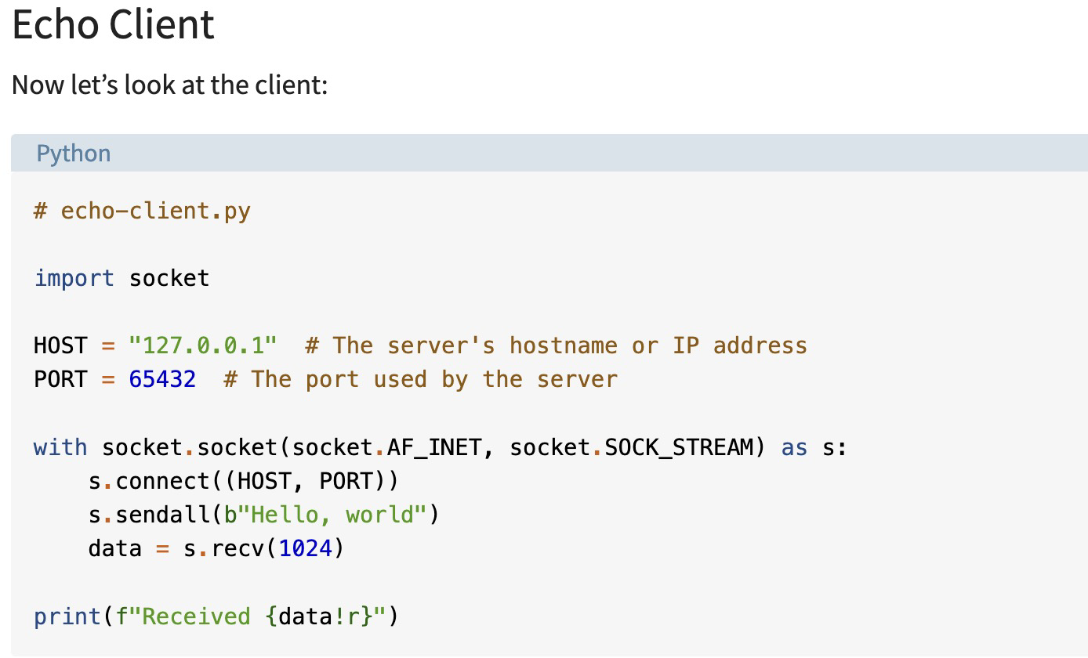
Example - TCP socket flow
https://realpython.com/python-sockets/

Slide 81
Thank you for your listening!
Q&A and Discussions!
Homework
Capture TCP 3-way handshake via Wireshark
Capture TCP 4-way handshake via Wireshark
Try the TCP sockets example (bonus)

